Slide 1

Systems architecture
and production
engineering
UC BERKELEY MFE
Lesson 9
Aneesh Sachdeva
November 2, 2026
01
Notes:
TEACHING POINT: Take a useful model into a reliable system.
EXPLAIN: The class builds on fitted pipelines and the separation of strategy, backtester, order management and analytics. Today the new boundaries are service, process, container and release.
QUESTION: What did we build last week?
ANSWER: Reusable research and model components.
TRANSITION: Show where those components will run.
TIME: approximately 1 minutes.

Slide 2
The system around a model
Prepared
features
Fitted
pipeline
Prediction
Last week: features, training, evaluation, backtesting.
Today: clear inputs, repeatable execution, other callers, visible failures.
2
Notes:
TEACHING POINT: Production engineering surrounds the model.
EXPLAIN: A prediction service accepts features and returns a prediction. Trade execution remains a separate responsibility. The same pipeline can be called by research code or a service.
QUESTION: What does a good backtest not prove?
ANSWER: That the service will accept the right inputs, run reliably, or deploy correctly.
TRANSITION: Introduce the five sections.
TIME: approximately 3 minutes.

Slide 3
Today’s lesson
Debugging and code quality
Testing
APIs and systems architecture
Containers
Continuous integration, deployment, and operation
3
Notes:
TEACHING POINT: Give students the route through the lesson.
EXPLAIN: Explain the progression from one function to a running service and a checked release. There are two short prepared demonstrations and an optional Docker extension.
QUESTION: Which boundary is familiar already?
ANSWER: Functions/modules and fitted pipelines.
TRANSITION: Use a deployment failure to establish the stakes.
TIME: approximately 1 minutes.

Slide 4
A deployment failure at Knight Capital
1
2
3
4
5
6
7
8
Seven servers received the new code; one did not.
A reused flag activated old behavior on the missed server.
Losses exceeded $460 million on August 1, 2012.
Verify the deployed version and watch the system after release.
4
Notes:
TEACHING POINT: Correct code is only one part of reliability.
EXPLAIN: The SEC order describes a failed deployment, obsolete code activated by a reused flag, and inadequate controls. Avoid reducing the incident to a single missing unit test. Source: https://www.sec.gov/litigation/admin/2013/34-70694.pdf
QUESTION: Would a passing test on one developer’s laptop catch a server missed during deployment?
ANSWER: No. Verify deployed versions and operational behavior as well.
TRANSITION: Start with how to investigate an unexpected result.
TIME: approximately 5 minutes.

Slide 5
Debugging and code quality
DEBUGGING
A repeatable failure gives you evidence to work with.
05
Notes:
TEACHING POINT: Investigate behavior before changing code.
EXPLAIN: This section moves from reproducing a problem to retaining evidence of the fix.
QUESTION: What evidence would you save first?
ANSWER: Input, expected result, actual result, versions and error/log context.
TRANSITION: Separate research exploration from reusable logic.
TIME: approximately 1 minutes.

Slide 6
Notebooks, modules, and services
Notebook
Batch job
API service
Reusable Python module
calculations / fitted pipeline
Keep the reusable calculation independently testable.
A notebook remains useful for research and presentation.
6
Notes:
TEACHING POINT: Separate reusable computation from its caller.
EXPLAIN: Notebooks can be tested and automated. Their hidden state and execution order require care; moving logic into modules lets notebooks, batch jobs and APIs reuse it. This continues the modular backtester lesson.
QUESTION: Where should fee logic live if both a notebook and API need it?
ANSWER: In a shared module.
TRANSITION: Use a systematic investigation loop.
TIME: approximately 4 minutes.

Slide 7
A systematic debugging process
1. Observe and reproduce
Save the exact input and result.
Make the failure repeatable.
3. Test an explanation
Change one assumption.
Compare expected and actual.
2. Isolate the cause
Reduce the input and code.
Inspect intermediate values.
4. Fix and verify
Keep a regression test.
Check nearby behavior.
7
Notes:
TEACHING POINT: Debugging is a sequence of falsifiable explanations.
EXPLAIN: Use print/logging for values, a debugger to step through control flow, and profilers for time/memory. Choose the tool for the question. Preserve the previous deck’s four-step structure.
QUESTION: Why change only one thing?
ANSWER: So a changed result is evidence about that explanation.
TRANSITION: Work through a small finance example.
TIME: approximately 4 minutes.

Slide 8
A calculation that runs but is wrong
2 shares × $100 × 10 basis points
10 basis points = 0.1% = 0.001
Expected fee = $0.20
return shares * price * fee_bps / 100
This line returns $20. Where is the unit conversion wrong?
8
Notes:
TEACHING POINT: A numerical bug can produce a plausible-looking number.
EXPLAIN: The denominator must be 10,000 for basis points. Establish the expected answer before reading the implementation. This is a teaching fee calculation with nonnegative quantity and no currency rounding.
QUESTION: What should the denominator be?
ANSWER: 10,000.
TRANSITION: Static tools and behavior tests catch different mistakes.
TIME: approximately 4 minutes.

Slide 9
Formatting, linting, and type checking
Formatting
Makes code layout consistent.
Ruff format
Linting
Flags likely mistakes such as an unused import.
Ruff check
Static type checking
Flags incompatible uses before execution.
mypy is one option.
Behavior tests
Check a specified result.
Our fee bug needs this check.
9
Notes:
TEACHING POINT: Name the categories before tool names.
EXPLAIN: The prior deck used Black, isort and flake8. Ruff handles formatting and many lint checks; it is not a type checker. Type annotations alone do not enforce runtime behavior. Source: https://docs.astral.sh/ruff/
QUESTION: Can a formatted, well-typed fee calculation still be wrong?
ANSWER: Yes: the basis-point denominator can be wrong.
TRANSITION: Show a small local check sequence.
TIME: approximately 4 minutes.

Slide 10
Local checks before a pull request
uv run ruff format --check .
uv run ruff check .
uv run pytest -q
Read the failing check and its file/line.
Fix the cause, rerun, then propose the change.
A Makefile can give these commands short names.
10
Notes:
TEACHING POINT: Make the feedback loop concrete.
EXPLAIN: Run the prepared project checks, or point to the saved results. Do not perform environment installation during the lecture. The Makefile offers shortcuts but is not needed on Windows.
QUESTION: Which check catches the wrong fee denominator?
ANSWER: The test.
TRANSITION: Turn a successful investigation into a permanent check.
TIME: approximately 3 minutes.

Slide 11
Testing
TESTING
Executable checks compare behavior with an independent expectation.
11
Notes:
TEACHING POINT: Retain executable evidence about behavior.
EXPLAIN: A regression test protects against reintroducing a known failure.
QUESTION: What should be independent of the implementation?
ANSWER: The expected behavior.
TRANSITION: Define the parts of a test.
TIME: approximately 1 minutes.

Slide 12
What a test checks
Known input
Actual result
Assertion
Expected result: $0.20, calculated independently.
Actual result: produced by the function.
Assertion: do they agree within the chosen tolerance?
12
Notes:
TEACHING POINT: The expected answer must not merely repeat the code under test.
EXPLAIN: The independent expected answer is 0.20. A test that recomputes the same wrong formula will pass and teach us nothing. Numerical tolerance should reflect the scale and meaning of the result.
QUESTION: Would copying the fee formula into the test help?
ANSWER: Only weakly; the same mistake can occur in both.
TRANSITION: Different scopes check different boundaries.
TIME: approximately 4 minutes.

Slide 13
Unit, integration, and end-to-end tests
UNIT: calculation alone
HTTP client
API + validation
Calculation
INTEGRATION: API, validation, and calculation together
END TO END: client → running container → response
13
Notes:
TEACHING POINT: Test scope means which components and boundaries are exercised.
EXPLAIN: In-process FastAPI TestClient covers validation and model integration but not actual TCP or container packaging. A real HTTP request to a running container covers additional boundaries. Avoid fixed 70/20/10 rules.
QUESTION: Which test catches a wrong host/container port mapping?
ANSWER: An end-to-end request to the running container.
TRANSITION: Read one small test line by line.
TIME: approximately 5 minutes.

Slide 14
A pytest test, line by line
def test_known_fee(fee_function):
actual = fee_function(
shares=2, price=100, fee_bps=10
)
assert actual == pytest.approx(0.20)
Arrange: inputs Act: call Assert: compare
Buggy version: $20 → corrected version: $0.20
14
Notes:
TEACHING POINT: A small test makes the intended behavior executable.
EXPLAIN: Explain pytest discovery of test_ names and approximate numeric comparison. The fee_function fixture selects the prepared buggy or fixed implementation; the test itself stays identical.
QUESTION: Why keep the same test when correcting the function?
ANSWER: It defines the intended behavior independently.
TRANSITION: Check nearby boundary and invalid cases.
TIME: approximately 8 minutes.
DEMO A: notebook “Demo A”. Predict the fee; show buggy output; run_fee_test("buggy"); inspect fixed function; run_fee_test("fixed"). The first failure is intentional. Use the saved reader if needed.

Slide 15
Boundary cases and invalid inputs
Contract: nonnegative quantity and fee; positive price.
Finite inputs only. Fractional shares are allowed.
Zero quantity
0 fee
Zero fee rate
0 fee
0.5 shares, $100, 10 bps
$0.05
Negative price / NaN
Reject with ValueError
15
Notes:
TEACHING POINT: State the contract before testing the boundary.
EXPLAIN: The example accepts fractional shares and no signed quantity. Real systems may use signed trades or decimal currency rules; those would be different contracts. NaN and infinity are not valid numeric inputs here.
QUESTION: Is zero quantity invalid?
ANSWER: No; the specified result is zero.
TRANSITION: Control external dependencies to keep tests repeatable.
TIME: approximately 5 minutes.

Slide 16
Repeatable tests and controlled dependencies
@pytest.fixture
def valid_input():
return {"momentum_20d": 0.02,
"volatility_20d": 0.15}
Fixture: supplies a known test input.
Mock: substitutes a dependency’s behavior.
Example: force model.predict to fail; verify a 500 response.
16
Notes:
TEACHING POINT: Control the dependency relevant to the test.
EXPLAIN: The fixture supplies known values. A mock can make inference raise an exception without depending on real infrastructure. Mock at a boundary; retain integration tests using the real pipeline as well. A fixed clock is preferable to assuming the test runs on a particular day.
QUESTION: Would mocking every model call test the saved artifact?
ANSWER: No; we also need real artifact integration tests.
TRANSITION: Separate service behavior from predictive quality.
TIME: approximately 4 minutes.

Slide 17
Software tests and model evaluations
Software tests
Does invalid input get rejected?
Are features in the correct order?
Does the API match direct Python?
Does saved preprocessing stay fixed?
Model evaluations
Does the forecast generalize?
Is the time split appropriate?
How does performance vary by regime?
Does it meet the intended use?
17
Notes:
TEACHING POINT: A reliable service can serve a weak model.
EXPLAIN: Recall time-aware evaluation from the modeling lessons. Our synthetic model only demonstrates mechanics. Compare a row alone versus in a batch to catch accidental preprocessing fits on requests; that is a software property, not proof of forecast quality.
QUESTION: If every API test passes, is the model profitable?
ANSWER: No. Predictive evidence is a different evaluation.
TRANSITION: Locate checks throughout development.
TIME: approximately 5 minutes.

Slide 18
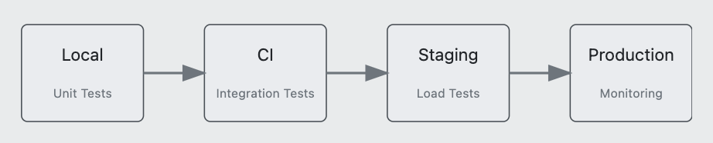
Checks across the development workflow
Examples, not restrictions: unit and integration tests run locally and in CI.
Staging adds realistic conditions; production adds live evidence.
18
Notes:
TEACHING POINT: Keep the previous course’s environment sequence.
EXPLAIN: The retained diagram gives typical examples, not a one-to-one restriction. CI is automated integration checking. Staging approximates production conditions; monitoring continues after tests have passed.
QUESTION: Why run the same checks in CI after running locally?
ANSWER: A clean, shared runner catches missing dependencies and provides review evidence.
TRANSITION: Break, then move from a callable function to a service.
TIME: approximately 3 minutes.
BREAK: 10:05–10:15 Pacific. Resume APIs by 10:15.

Slide 19
APIs and systems architecture
APIS AND ARCHITECTURE
A network boundary makes the request contract explicit.
19
Notes:
TEACHING POINT: An API defines how programs interact.
EXPLAIN: Expand API as application programming interface. Today we focus on an HTTP API. Define client and server before using the architecture diagrams.
QUESTION: Who is the client in our demo?
ANSWER: The notebook making the request.
TRANSITION: Compare the two ways to call the model.
TIME: approximately 1 minutes.

Slide 20
A function call and a network request
One Python process
Two processes
Caller
Function
Client
Server
Values passed in memory
JSON over HTTP
Status + response body
Network failures are possible
20
Notes:
TEACHING POINT: Separate processes create a communication boundary.
EXPLAIN: Both processes run on the same laptop in the demo; they could run on different machines. Serialization converts values into a transmissible representation. A timeout can occur even when the model code is correct.
QUESTION: Does localhost mean the code runs in the same process?
ANSWER: No. It identifies this machine.
TRANSITION: Read one concrete HTTP exchange.
TIME: approximately 4 minutes.

Slide 21
The HTTP request and response
POST http://127.0.0.1:8769/predict
Content-Type: application/json
{"momentum_20d": 0.02,
"volatility_20d": 0.15}
200 OK: prediction + model_version
422: request violates the input contract
500: the service could not complete inference
21
Notes:
TEACHING POINT: Endpoint, method, body and status are concrete parts of a request.
EXPLAIN: The endpoint is the address for this operation; POST sends the features in a body. GET /health reads readiness. POST does not always mean creating a database record. Responses are structured JSON plus an HTTP status.
QUESTION: Why is a missing input a 422 rather than a prediction of zero?
ANSWER: The caller has not supplied a valid request.
TRANSITION: Specify the units and valid domain.
TIME: approximately 4 minutes.

Slide 22
The prediction contract
Input features
momentum_20d
20-day return, as a fraction.
Allowed: −1 to 1.
volatility_20d
Annualized volatility, as a fraction.
Allowed: 0 to 2.
Output
prediction: return as a fraction
model_version: classroom-v1
Examples
0.02 means 2%, not 0.02%.
A missing field is rejected.
Unknown fields are rejected.
22
Notes:
TEACHING POINT: Type and shape checks are necessary but do not establish semantics.
EXPLAIN: The domain bounds are chosen for this classroom service and are explicit, not universal finance rules. Numeric strings and booleans are rejected in this strict schema. Both input feature definitions must match training.
QUESTION: Would 0.02 versus 2 always be caught by a float type?
ANSWER: No. Units and domain bounds matter.
TRANSITION: Trace the contract through the server.
TIME: approximately 4 minutes.

Slide 23
The request–response cycle
Server process
Client
Route
/predict
Validate
input
Fitted
pipeline
422 + error
200 + prediction + model_version
23
Notes:
TEACHING POINT: Validation happens before the prediction function is called.
EXPLAIN: Read left to right through the route, schema and fitted pipeline, then follow the response back to the client. The invalid branch returns before inference. This redraws the earlier request-cycle diagram with a clearer execution order.
QUESTION: Where does the request with a missing field stop?
ANSWER: At validation.
TRANSITION: Explain where the fitted pipeline came from.
TIME: approximately 5 minutes.

Slide 24
Training and serving the same pipeline
Training data
Fit scaler
and model
Save artifact
New features
Load fitted
pipeline
Predict
Fit during training. Reuse the fitted transforms during serving.
24
Notes:
TEACHING POINT: The trained preprocessing is part of the model artifact.
EXPLAIN: Our saved sklearn Pipeline contains StandardScaler and LinearRegression. Serving calls predict, not fit. Code, feature schema, dependency versions and model artifact must stay compatible. Load only trusted serialized artifacts.
QUESTION: What happens if you fit a scaler to each request?
ANSWER: The feature transformation changes with the request and no longer matches training.
TRANSITION: Place artifact loading on the process timeline.
TIME: approximately 4 minutes.

Slide 25
Model lifetime inside a service
Process starts
Load once
Many requests
Process stops
@asynccontextmanager
async def lifespan(app):
app.state.bundle = joblib.load(MODEL_PATH)
yield
del app.state.bundle
25
Notes:
TEACHING POINT: Load the model once for each worker process.
EXPLAIN: FastAPI lifespan handles startup and shutdown. The route in our demo is a normal synchronous def because it calls synchronous model code. async does not itself accelerate CPU computation. Model copies and concurrent requests consume resources. Source: https://fastapi.tiangolo.com/advanced/events/
QUESTION: If four worker processes start, how many separate loads may occur?
ANSWER: Four, one per process in this example.
TRANSITION: Run the prepared service demonstration.
TIME: approximately 4 minutes.

Slide 26
Calling and testing the service
direct = pipeline.predict(row)[0]
response = httpx.post(
base_url + "/predict", json=payload
)
assert response.json()["prediction"] == approx(direct)
Valid input → 200 and the same prediction.
Missing feature → 422 before inference.
26
Notes:
TEACHING POINT: The same computation can be reached through a network interface.
EXPLAIN: Use the already running server. Show direct prediction, HTTP response and version, matching values, then the missing-field response. The actual notebook imports pytest.approx; the slide shortens the name.
QUESTION: Which parts are new compared with pipeline.predict?
ANSWER: Serialization, HTTP, validation, response schema and possible transport failures.
TRANSITION: Consider whether every use needs an online API.
TIME: approximately 7 minutes.
DEMO B: notebook “Demo B”. Four prepared cells; then optionally run service tests. Expected direct result is approximately -0.005. This is synthetic, not predictive evidence. Use saved reader if needed.

Slide 27
Batch scoring and online requests
Batch scoring
Score many rows on a schedule.
Optimize throughput and completion time.
Retry or resume a failed partition.
Example: nightly research signals.
Online requests
Answer a caller as inputs arrive.
Bound latency and concurrent load.
Return clear errors and timeouts.
Example: an interactive prediction.
27
Notes:
TEACHING POINT: Choose the interface from the user’s need.
EXPLAIN: Batch jobs can use the same fitted pipeline without an HTTP call for every row. Online serving is appropriate when callers need individual results promptly. Batching can also happen within an online service.
QUESTION: Does a nightly job necessarily need an API?
ANSWER: No; a batch process may be simpler.
TRANSITION: Scale the online path only where needed.
TIME: approximately 3 minutes.

Slide 28
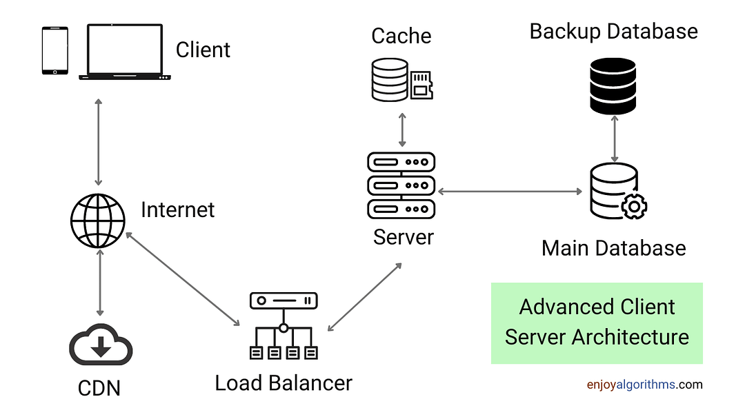
Adding workers and a load balancer
Load balancer
Routes requests to workers.
Workers
Run service processes.
Shared storage
Keeps durable state.
Add components for a measured need: load, availability, or durable state.
28
Notes:
TEACHING POINT: Retain the previous course’s client/server architecture visual.
EXPLAIN: Trace client, network, load balancer, server and database. A server box may represent multiple workers or machines. A cache helps repeated reads; a CDN serves suitable cached content. Neither is required for our small model demo.
QUESTION: Why keep state outside a replaceable worker?
ANSWER: So replacing a worker does not lose durable data.
TRANSITION: More workers have a memory cost.
TIME: approximately 3 minutes.

Slide 29
The memory cost of more workers
Worker 1
500 MB model
Worker 2
500 MB model
Worker 3
500 MB model
Worker 4
500 MB model
4 separate copies × 500 MB ≈ 2 GB
plus Python, libraries, request data, and buffers.
Illustrative budget: assumes one independent model copy per process.
29
Notes:
TEACHING POINT: Concurrency and memory trade off.
EXPLAIN: This is an explicit assumption, not a universal rule. Shared memory and copy-on-write can change the physical footprint. CPU saturation, memory and latency measurements determine useful worker count.
QUESTION: Why might adding workers make the service worse?
ANSWER: Memory pressure or contention can outweigh additional concurrency.
TRANSITION: Now consider a network failure after successful work.
TIME: approximately 3 minutes.

Slide 30
Timeouts, retries, and repeated requests
Request
Client
Service
Work completes; response is lost
Retry: is repeating the operation safe?
30
Notes:
TEACHING POINT: A timeout does not prove the operation failed.
EXPLAIN: Repeated pure scoring is usually safe with fixed version and input. Repeated order submission can duplicate a trade. Idempotency means repeating the operation has the same intended effect; use a durable idempotency key for state-changing actions. Bound retries with backoff and a deadline; use request IDs for diagnosis and reject or queue overload.
QUESTION: Should a client blindly retry an order after a timeout?
ANSWER: No. It needs a way to identify the original operation and deduplicate safely.
TRANSITION: Package the service so it can run elsewhere.
TIME: approximately 3 minutes.

Slide 31
Containers
CONTAINERS
Package the runtime, code, and fitted model for repeatable execution.
31
Notes:
TEACHING POINT: Package the service and its runtime dependencies.
EXPLAIN: Keep the original section divider. The next diagrams explain what is isolated and what is shared.
QUESTION: What needs to travel with app.py?
ANSWER: Dependencies, model artifact and runtime configuration conventions.
TRANSITION: Compare familiar environments to containers and VMs.
TIME: approximately 1 minutes.

Slide 32
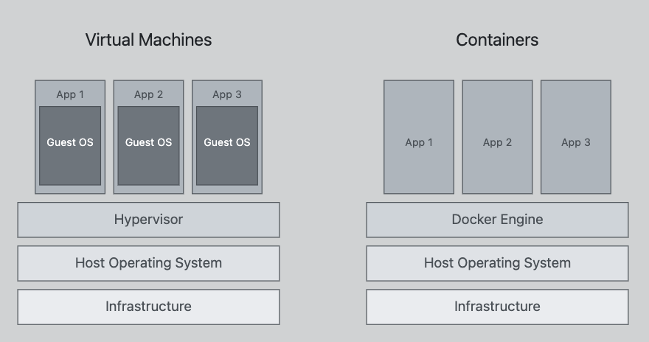
Environments, containers, and virtual machines
Python environment
Isolates Python packages.
Container
Isolates processes/files;
shares a kernel.
Virtual machine
Runs a guest OS.
Linux containers on a Mac typically run inside a Linux VM.
32
Notes:
TEACHING POINT: Retain the original layered VM/container comparison.
EXPLAIN: An image is a package; a container is a running isolated process environment. Containers share the kernel of their Linux host or VM. They do not contain an independent operating-system kernel like a VM. Avoid universal claims about size and speed.
QUESTION: Does a Python virtual environment isolate the OS?
ANSWER: No; it primarily separates Python dependencies.
TRANSITION: Separate the package from its running instances.
TIME: approximately 5 minutes.

Slide 33
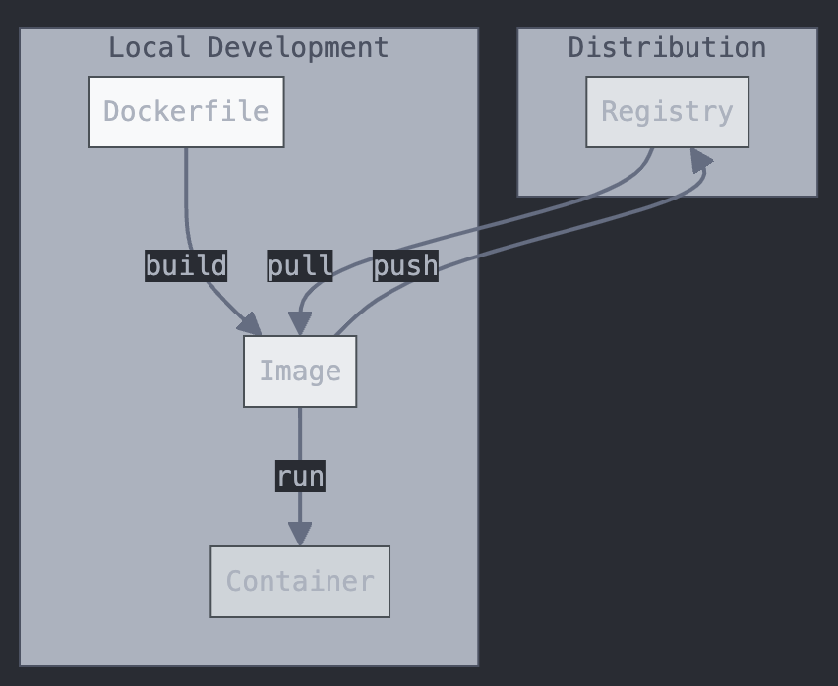
Images, containers, and registries
Image
Code, model, and runtime.
Container
A running image instance.
Registry
Stores and distributes images.
Tags can move. A digest identifies exact image content.
33
Notes:
TEACHING POINT: Keep the original build, push, pull and run relationships.
EXPLAIN: The Dockerfile builds an image; a registry distributes it; run creates a container. The diagram’s image is the same artifact across distribution. Multiple containers can run the same image.
QUESTION: Does stopping a container delete the image?
ANSWER: No.
TRANSITION: Read the Dockerfile for our actual service.
TIME: approximately 5 minutes.

Slide 34
A Dockerfile for the service
FROM python:3.12-slim
WORKDIR /app
COPY requirements.txt .
RUN pip install --no-cache-dir -r requirements.txt
COPY app.py .
COPY artifacts/ artifacts/
EXPOSE 8000
CMD ["uvicorn", "app:app", "--host", "0.0.0.0", "--port", "8000"]
Build: install dependencies and copy files.
Run: start the API process. requirements.txt comes from uv.lock.
34
Notes:
TEACHING POINT: Use the same artifact and locked application dependencies.
EXPLAIN: This is the exact demo Dockerfile. uv exports runtime dependencies from the lock; the container excludes Jupyter and test tools. EXPOSE documents a port; it does not publish the port on the host. The base tag is convenient for class; release processes should record its digest too.
QUESTION: Which line executes when a container starts?
ANSWER: CMD. RUN executes while building the image.
TRANSITION: Show how a client reaches that process.
TIME: approximately 5 minutes.

Slide 35
Ports, configuration, and stored data
Host: localhost:8770
Container: port 8000
-p 127.0.0.1:8770:8000
Configuration enters at runtime. Keep secrets out of the image.
Keep durable outputs in a volume or external store.
Replacing an instance should not erase business records.
35
Notes:
TEACHING POINT: Port mapping connects boundaries; storage has a separate lifetime.
EXPLAIN: Bind the demo to loopback so it is local to this computer. The packaged model stays in the image; ad hoc writes in a removed container do not. The classroom prediction service is stateless and writes no durable business records.
QUESTION: Does EXPOSE 8000 make localhost:8000 work automatically?
ANSWER: No; publish the host port with -p.
TRANSITION: Repeat the familiar request through the container.
TIME: approximately 5 minutes.

Slide 36
The same request inside a container
docker build -t mfe-lesson9:classroom-v1 .
docker run --rm --name mfe-lesson9-demo \
-p 127.0.0.1:8770:8000 mfe-lesson9:classroom-v1
Send the same JSON to localhost:8770/predict.
Compare the prediction and model version.
Restart the image: the packaged model is still there.
36
Notes:
TEACHING POINT: Packaging changes the runtime boundary, not the model contract.
EXPLAIN: Use the image built before class. Send the same payload as Demo B, stop and restart the same image, and repeat. Explain that the model was copied into the image, while mutable runtime writes require separate persistence.
QUESTION: Which port belongs to the host?
ANSWER: 8770; 8000 belongs to the service inside the container.
TRANSITION: Take the same checked artifact into a release workflow.
TIME: approximately 4 minutes.
OPTIONAL DEMO C. Skip if time is short; use Docker_Verification.txt if live setup fails. Start CI by 11:25 Pacific.

Slide 37
Continuous integration
and deployment
CI AND DEPLOYMENT
Automated checks and versioned releases support reliable operation.
37
Notes:
TEACHING POINT: Define the terms before drawing the workflow.
EXPLAIN: CI automatically checks proposed/integrated changes. Continuous delivery keeps a releasable artifact ready; continuous deployment automatically releases changes that meet the gates.
QUESTION: Does a passing test automatically imply a production deploy?
ANSWER: No; that depends on the release policy.
TRANSITION: Follow a pull request into a runner.
TIME: approximately 1 minutes.

Slide 38
A pull request runs automated checks
Pull request
Clean runner
Lint + tests
Check result
steps:
- run: uv sync --locked
- run: uv run --locked ruff check .
- run: uv run --locked ruff format --check .
- run: uv run --locked pytest -q
Required status checks must be configured to block merging.
38
Notes:
TEACHING POINT: CI gives the reviewer repeatable evidence on the proposed change.
EXPLAIN: The project includes a complete GitHub Actions workflow with checkout, Python setup and scoped working directory; this excerpt shows the checks. Running a workflow does not by itself make a failed result block merging. That requires repository rules. No live GitHub wait is needed. Source: https://docs.github.com/en/actions/get-started/continuous-integration
QUESTION: Why install from a lockfile?
ANSWER: To use recorded dependency versions rather than resolve a fresh set each time.
TRANSITION: Build and release a known artifact.
TIME: approximately 5 minutes.

Slide 39
Releasing a known version
Commit + lock
+ model
Build image
Check image
Deploy image
Record the image digest and model version.
Promote the same checked artifact between environments.
Retain the previous image and a recovery procedure.
39
Notes:
TEACHING POINT: The deployed artifact should be the one that was checked.
EXPLAIN: Distinguish checking source from checking the built image. Run a smoke request on the image, deploy by recorded identity, and verify readiness. A rollback is straightforward for this stateless prediction service; state migrations may require additional planning.
QUESTION: Why not rebuild separately in every environment?
ANSWER: The environment could get a different artifact or dependencies.
TRANSITION: Observe the system after the release.
TIME: approximately 4 minutes.

Slide 40
Monitoring and recovery
Deploy v2
Errors rise
Inspect evidence
Restore v1
Service: errors, latency, throughput, memory.
Data: missing fields, feature ranges, changing distributions.
Model: quality evidence when outcomes become available.
A request ID connects a failed response to its server log.
40
Notes:
TEACHING POINT: Tests do not replace observation after deployment.
EXPLAIN: Our app returns an X-Request-ID and logs inference failures with that ID. Do not put sensitive feature payloads into logs by default. A healthy process can still receive wrong data or serve a weak model. Predictive quality can be delayed until labels arrive.
QUESTION: If latency is fine but forecasts changed, what would you inspect?
ANSWER: Model version, feature units/order, preprocessing and input distribution.
TRANSITION: Apply the same evidence to AI-generated code.
TIME: approximately 5 minutes.

Slide 41
Reviewing an AI-generated change
# Proposed “simplification”
pipeline.fit(request_rows, request_targets)
return pipeline.predict(request_rows)
Contract: serving reuses a fitted pipeline.
Review: does this change refit on each request?
Evidence: test row-alone versus row-in-batch consistency.
Decision: keep training outside the prediction route.
41
Notes:
TEACHING POINT: Review the intended behavior and evidence, whoever wrote the code.
EXPLAIN: The proposed snippet is illustrative and intentionally violates the contract; prediction requests do not even contain training targets. Review for semantic errors, run focused regression checks, then run the integration suite. An agent tool can call this same API, using the same schema.
QUESTION: Would syntactically valid code be enough to approve this?
ANSWER: No; the change violates the serving contract.
TRANSITION: Use a few interview scenarios to consolidate.
TIME: approximately 5 minutes.

Slide 42
System-design interview checkpoint
1. Valid JSON, incorrect predictions.
Which boundary and evidence do you inspect?
2. More workers, growing RAM, worse latency.
What trade-off would you measure?
3. Errors rise immediately after a release.
What would you compare and how would you recover?
42
Notes:
TEACHING POINT: Reason from symptoms to boundaries and evidence.
EXPLAIN: Give students time to answer each situation. Do not require cloud product names.
QUESTION: What would you inspect in each scenario?
ANSWER: 1: units, feature ordering, artifact version, saved preprocessing; compare direct and API on known input. 2: per-worker model memory, CPU saturation, concurrency and request latency. 3: error logs/request IDs, changed versions, deployment health; restore the previous known artifact when appropriate.
TRANSITION: Turn the lesson into a small practice project.
TIME: approximately 6 minutes.

Slide 43
Productionization practice
Serve a saved pipeline through a documented /predict contract.
Test a known result, invalid inputs, and inference failure.
Package the service and repeat a request to the container.
Run checks in CI and show the result.
Record the model version and explain recovery.
Practice outline; submission details belong in the published assignment.
43
Notes:
TEACHING POINT: Reuse the previous HW5 shape without inventing a new assignment policy.
EXPLAIN: This is the same endpoint/tests/container/automation progression used in January 2026 HW5. The demo provides a complete reference; students should be able to explain the contract and checks. Do not announce a new deadline from this slide.
QUESTION: What evidence demonstrates that the service works?
ANSWER: Known-result and invalid-input tests, a real container request, and CI output.
TRANSITION: Return to the full system map.
TIME: approximately 4 minutes.

Slide 44
The complete system
Features
API validation
Fitted pipeline
Prediction
Tests + CI
Versioned image
Monitoring + recovery
44
Notes:
TEACHING POINT: Connect a request and a code change end to end.
EXPLAIN: Trace the request across the upper row. Then trace a change through tests, CI, a versioned image and operational observation. The model is one component of the service.
QUESTION: Explain one request and one code change through this diagram.
ANSWER: Request: serialized inputs, validation, saved transforms, prediction and response. Change: review, checks, build/version, deploy, monitor and recover.
TRANSITION: Questions; optional references follow.
TIME: approximately 5 minutes.

Slide 45
Reference: static-analysis tools
Ruff format
Consistent layout.
Ruff check
Lint rules and import checks.
pytest
Executable behavior checks.
mypy
Optional static type analysis.
Earlier course tools
Black, isort, and flake8 served related formatting and linting roles.
A clean lint result does not prove correctness.
A1
Notes:
TEACHING POINT: Reference tool categories.
EXPLAIN: Use only if students ask about the older stack. Tool choice follows project constraints; do not add a second lint toolchain to the demo.
QUESTION: Is Ruff a replacement for all tests and type analysis?
ANSWER: No.
TRANSITION: Return to the relevant section.
TIME: approximately 0 minutes.

Slide 46
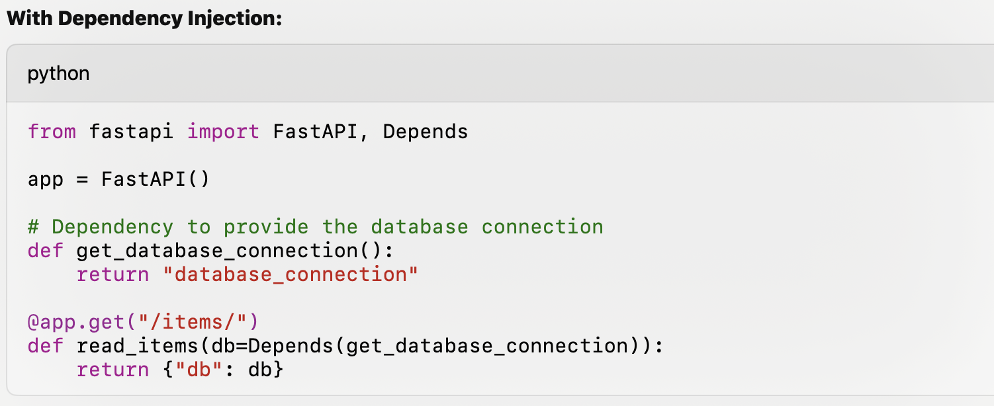
Reference: dependency injection
A dependency function supplies a resource.
Tests can substitute it.
Depends alone does not create a connection pool.
A2
Notes:
TEACHING POINT: Retain the earlier concrete Depends example.
EXPLAIN: The original screenshot is illustrative: it returns a string, not a real database connection. Injection separates acquisition from use and supports test overrides. Resource lifetime and pooling still need explicit design.
QUESTION: Does Depends automatically make database access efficient?
ANSWER: No.
TRANSITION: Return to testing or model lifetime.
TIME: approximately 0 minutes.

Slide 47
Reference: HTTP methods
GET
Read a representation.
POST
Submit data for processing; may create a resource.
DELETE
Remove a resource.
PUT
Replace the representation at a resource address.
PATCH
Apply a partial update.
Status and response bodies communicate the outcome.
A3
Notes:
TEACHING POINT: Use method semantics consistently.
EXPLAIN: The prediction endpoint uses POST because it accepts a structured input body for computation; it need not create a persistent record. GET should not cause the client to intentionally change server state.
QUESTION: Is every POST a database create?
ANSWER: No.
TRANSITION: Return to the HTTP exchange.
TIME: approximately 0 minutes.

Slide 48
Reference: project layout and Makefile
demo/
app.py
fees.py
artifacts/model.joblib
tests/
pyproject.toml + uv.lock
requirements.txt
Dockerfile + Makefile
make test
Runs pytest.
make lint
Runs lint + formatting checks.
make build / make run
Builds / runs the container.
A4
Notes:
TEACHING POINT: Keep the prior homework’s file organization recognizable.
EXPLAIN: The full commands are in README for platforms without make. The course-root GitHub workflow points its working directory at this demo folder. Notebook orchestration lives outside business logic.
QUESTION: Where is the model loaded?
ANSWER: app.py lifespan, from artifacts/model.joblib.
TRANSITION: Return to practice.
TIME: approximately 0 minutes.

Slide 49

Reference: Netflix architecture video
Original course video · optional systems discussion
A5
Notes:
TEACHING POINT: Preserve the original embedded video.
EXPLAIN: Original video: https://www.youtube.com/watch?v=CZ3wIuvmHeM . Discuss client, service boundary, load balancing and failure isolation rather than memorizing the entire architecture. The main lesson does not depend on playback.
QUESTION: Which problems justify additional services?
ANSWER: Independent scaling, ownership, availability and fault isolation, balanced against communication complexity.
TRANSITION: Return to the load-balancing discussion.
TIME: approximately 0 minutes.

Slide 50
Reference: LLM serving uses the same boundaries
Client / agent
API + queue
GPU worker
Generated tokens
Model weights occupy memory before a request arrives.
Active requests also need runtime state, including KV cache.
Concurrency, batch size, context length, and latency trade off.
A6
Notes:
TEACHING POINT: Connect to Lesson 6 without teaching a second LLM module.
EXPLAIN: The architectural pattern is familiar: request contract, queue, workers, model lifetime and observation. KV cache belongs to active generation context; memory usage depends on model architecture, precision and serving strategy. Avoid a universal GB-per-token rule.
QUESTION: What consumes memory besides weights?
ANSWER: Runtime buffers and per-request state such as KV cache.
TRANSITION: Questions.
TIME: approximately 0 minutes.

